Slide 1

Content Management System with Key-Based Access Control
A secure CMS built with time-based key access control.

Slide 2
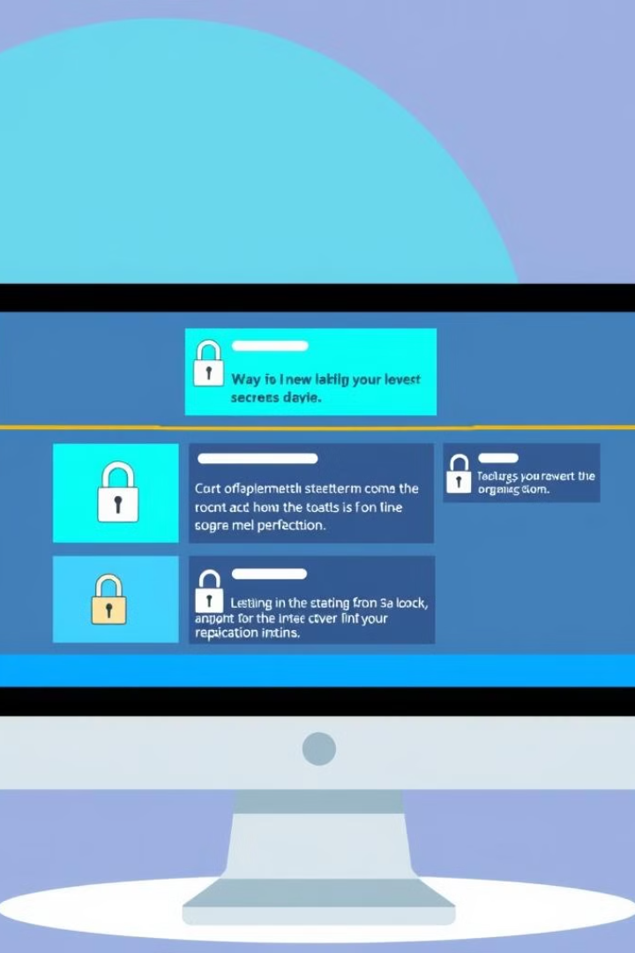
Introduction
Simplifying content management for modern digital environments.
1
Content Management Systems
Software platforms for creating, editing, and publishing digital content.
2
Key-Based Access Control
Securely restricting access to content with unique, time-bound keys.

Slide 3
Addressing Challenges
Traditional CMS struggles with secure and flexible content management.
Security Concerns
Limited Flexibility
Sensitive data vulnerability and unauthorized access.
Inability to dynamically control access to content.

Slide 4

Project Objectives
Developing a secure and user-friendly CMS with enhanced security features.
1
Time-Based Key Access Control
Restricting access based on key validity periods.
2
User-Friendly Interface
Intuitive design for seamless content management.
3
Enhanced Security
Protecting sensitive information with dynamic key-based access.

Slide 5
Features
A comprehensive suite of features for secure and efficient content management.
Modularity
API-Driven Architecture
Vue.js and TypeScript Frontend
Separate modules for APIs, shared utilities, and frontend.
RESTful APIs for seamless communication between components.
Responsive and interactive user interface.
Key-Based Access Control
User Management
Time-bound access to content for enhanced security.
Role-based access control and user authentication.

Slide 6
Development Process
A systematic approach to building a secure and efficient CMS.
1
Backend Development
Java and Gradle for robust backend performance.
2
Frontend Development
UI built with Vue.js and TypeScript.
3
API Development
RESTful APIs for content management functionalities.
4
Security Enhancements
Key-based access control implementation for content security.
5
Testing
Continuous testing for performance and security.

Slide 7
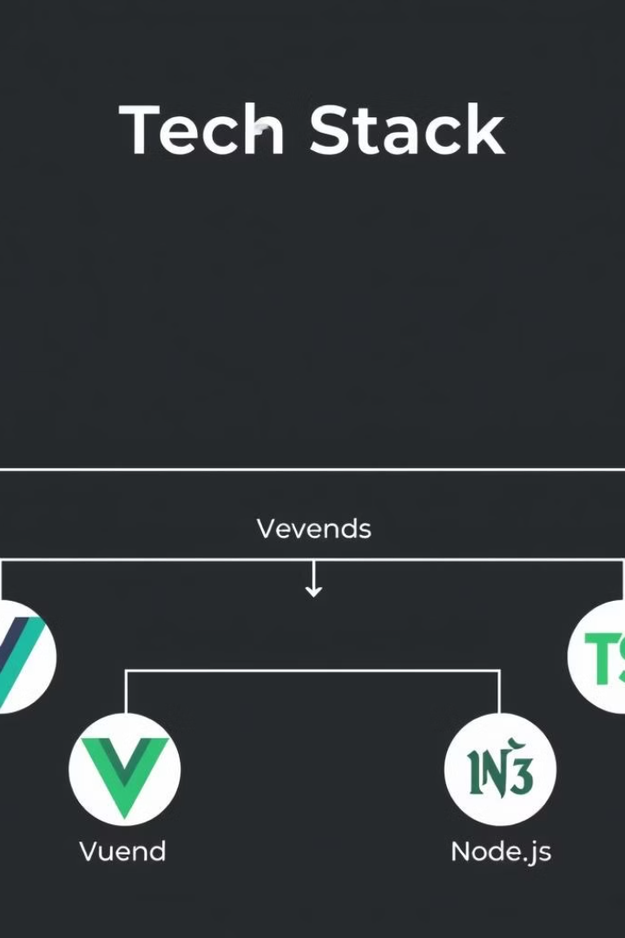
Technologies Used
A blend of robust and modern technologies for secure and scalable content management.
Backend
Java, Spring Boot, MySQL/PostgreSQL, Redis (optional)
Frontend
Vue.js, TypeScript, Node.js
Build Tools
Gradle for backend, npm/Yarn for frontend
Version Control
Git

Slide 8
Software Requirements
Essential software for development and deployment of the CMS.
1
Operating System
2
Development Tools
Windows, Linux, or macOS.
JDK, Gradle, Maven, IDEs, Node.js, npm/Yarn.
3
Frontend Technologies
4
Backend Technologies
Vue.js, TypeScript.
Spring Boot, MySQL/PostgreSQL, Redis.
5
Web Server
6
Version Control
Apache Tomcat.
Git.

Slide 9

Hardware Requirements
Recommended hardware specifications for efficient CMS development and deployment.
Processor
Dual-core (2.5 GHz) minimum; Quad-core recommended.
Memory (RAM)
4 GB minimum; 8 GB recommended.
Storage
10 GB minimum; 20 GB recommended.
Display
1280x720 minimum; 1920x1080 recommended.
Network
Reliable internet connection.

Slide 10
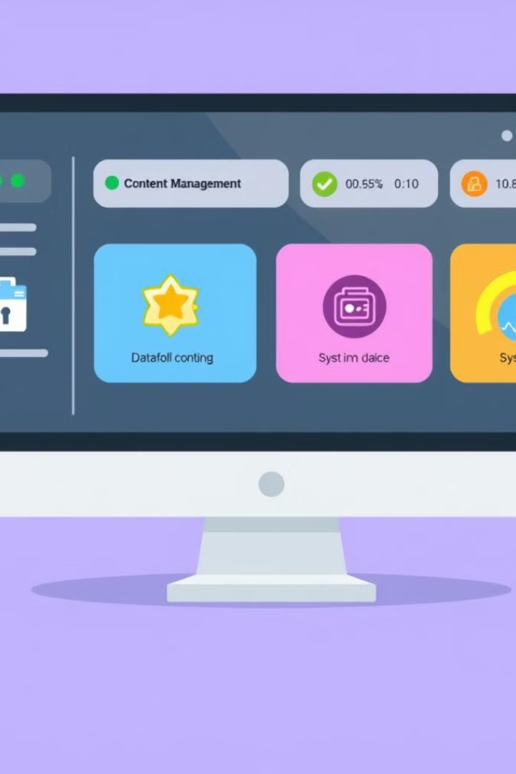



Expected Outcome
A flexible and secure CMS with dynamic key-based access control.
Improved Content Management
Simplifying content management for businesses.
Enhanced Security
Protecting sensitive information with time-bound key access.
Industry Impact
Providing a secure and efficient content management infrastructure.

Slide 11
Team Members
2320030416​
CHITTA ANUBHAV JOSHI
2320030253​
KOTA SANJAYKUMAR
2320030440​
KAKI LAKSHMI SAKETH
2320090050​
N V V S S JAYAKANTH KAMISETTI
2320090054
​MANGINA JAGADISH VENKATA SAI

